Slide 1

Dr Wanda Wyporska, FRSA,
Visiting Fellow, University of York
Executive Director

Slide 2
Can we really gain equality in the workplace?
Notes:
Effects of globalisation?
Globalisation can increase inequality through increased tax evasion.
There is disagreement about whether trade liberalisation increases or decreases inequality.
The globalized economic system may allow for concentrations of wealth at the top of the income spectrum. Some suggest that this is only achieved through complicity of the local political system and that political decisions are crucial in understanding how economic factors influence inequality.
Liberalisation of export rules may increase pay inequality between people working in the same industry. Research suggests that this may be because increased trade with developing nations has improved average living standards (by making goods more affordable) but decreased wages of low-skilled workers due to foreign competition, thereby increasing the gap between the middle and the bottom.

Slide 3
Wealth Tracker
Richest 1,000 people own more wealth than 40% of households, or 10.2 million families.
In the last year alone the combined wealth of Britain’s 1,000 richest people increased by £82.5 billion to £658 billion.

Slide 4
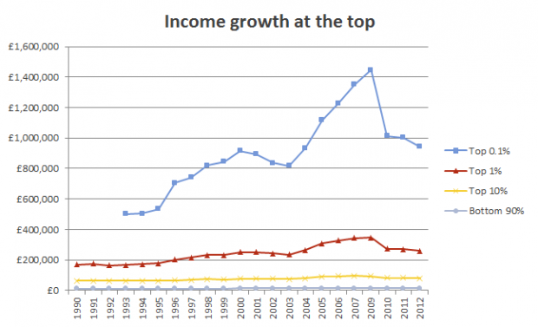

Slide 5
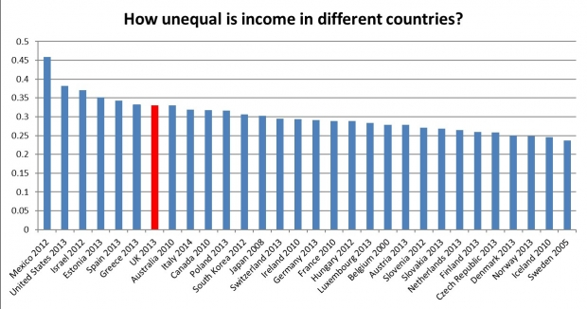
Notes:
The UK is currently one of the most unequal countries in the developed world. As you can see from this graph which shows the level of inequality in 30 OECD countries. The UK only has lower inequality than Mexico, the US, and Israel. Graph from: http://www.equalitytrust.org.uk/about-inequality/scale-and-trends Data from: http://www.lisdatacenter.org/

Slide 6
Pay Tracker
CEOs in the UK’s top 100 companies now pocket an average of £5.3m* each year, or 386 times that of a worker earning the National Living Wage.
Over two thirds (67%) of FTSE 100 CEOs are paid more than 100 times the average UK salary. Ninety per cent of FTSE 100 CEOs are paid at least 100 times more than the National Living Wage.
Equality Trust analysis also found that FTSE 100 CEOs are now paid:
• 165 times more than a nurse.
• 140 times more than a teacher.
• 132 times more than a police officer.
• 312 times more than a care worker.

Slide 7
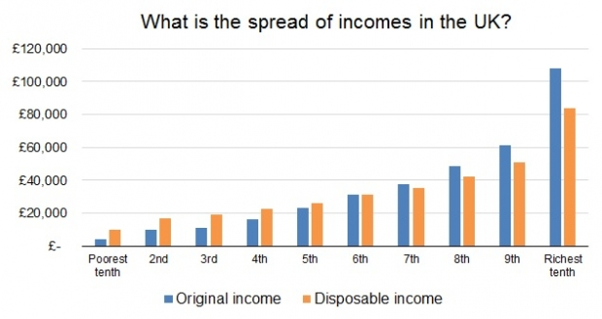
Notes:
This chart shows how much income each group gets in a year with the poorest group on the left and the richest on the right. The blue bars represent income before tax and benefits, the orange bars represent income after tax and benefits. Before tax and benefit the poorest 10% have on average £4k and the richest 10% has on average £105k (over 27 times as much). After tax and benefits, the poorest 10% has on average around £9k a year and a household in the top 10% has on average around £80,000 (almost 9 times as much). Graph from: http://www.equalitytrust.org.uk/about-inequality/scale-and-trends Data from: http://www.ons.gov.uk/ons/rel/household-income/the-effects-of-taxes-and-benefits-on-household-income/2012-13/index.html

Slide 8
Inequality as a threat
IMF “Lower net inequality is robustly correlated with faster and more durable growth."
OECD “Policies to reduce income inequalities should not only be pursued to improve social outcomes but also to sustain long-term growth."
CBI “Research from the IMF shows that nations with higher inequality tend to enjoy shorter periods of growth, and also tend to grow more slowly.”

Slide 9
Drivers of inequality
  Technology: smaller businesses, more higher skilled and fewer lower skilled jobs
  Childhood: SES, parental income (50% in UK v 15-25% in Nordic countries) as a predictor
  Education: good early years provision
  Political systems: proportional representation, increased democracy
  Globalisation: inequality increasing within countries and decreasing between countries

Slide 10
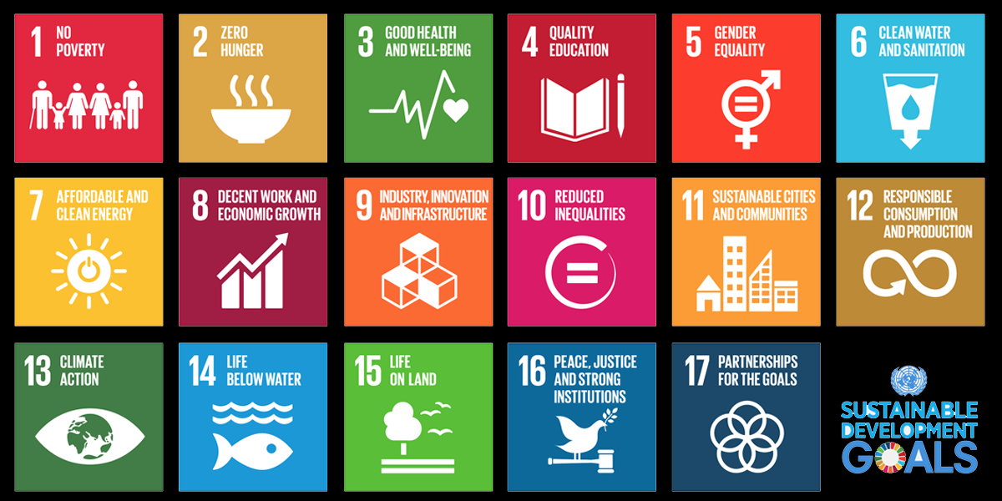

Slide 11
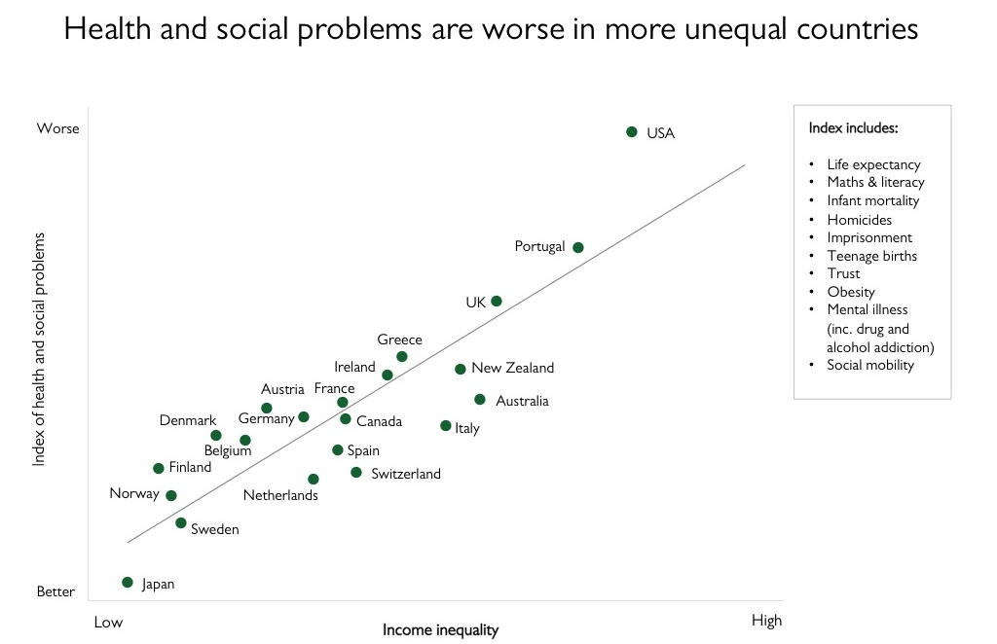

Slide 12
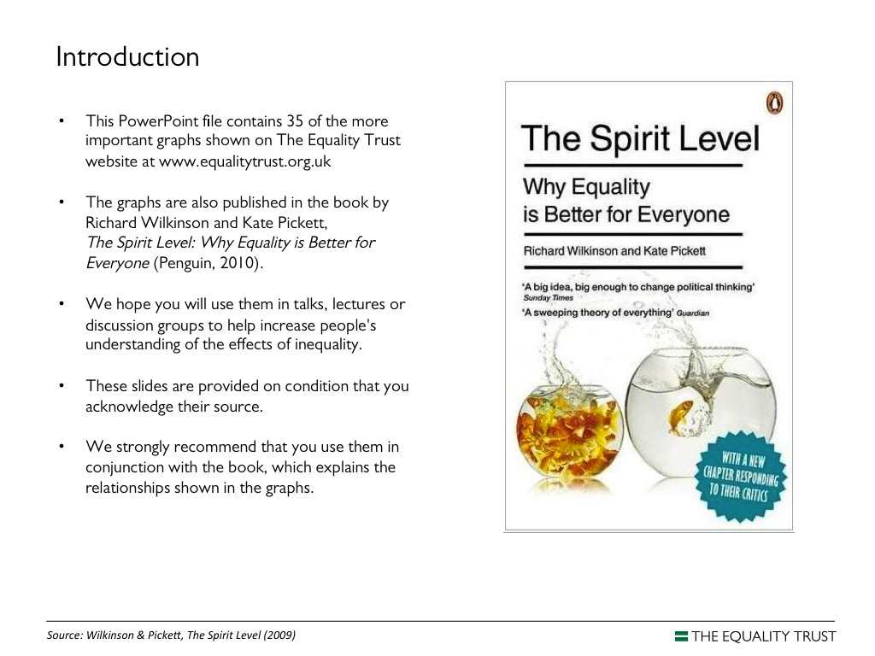
Reflections on the effects of inequality
Education and Social Mobility
Crisis, debt and inflation
Physical health
Mental Health
Engagement with Politics and Society
Trust
Notes:
Education and Social Mobility
Very strong relationship between high levels of income inequality and low levels of social mobility.
Children of highly paid people are more likely to be highly paid and children of low paid people more likely to be low earners.
Countries with higher levels of income inequality have lower levels of social mobility
The link between inequality and a lack of social mobility exists throughout a person’s life. Such links are stronger than the link between social mobility and poverty.
Crisis, debt and inflation
Increased inequality can lead to financial crises.
High levels of income inequality are associated with economic instability and crises, whereas more equal societies tend to have longer periods of sustained growth.
High levels of income inequality lead to higher levels of personal and institutional debt. There is substantial evidence to suggest that increased inequality was at least partially responsible for the increase in debt that precipitated the US financial crisis.
Inequality may have played a role in the UK financial crisis by increasing debt and over-consumption, but these effects could also have been small.
Increased inequality may increase rates of inflation.
Physical health
Overall levels of physical health and life expectancy are lower in more economically unequal developed countries. Heathy life expectancy in Barking and Dagenham for women 55.5 v Richmond upon Thames 71.2.
People living in regions with high income inequality have an excess risk of premature mortality and poor self-rated health, independent of their socio-economic status, age, and sex.
The estimated excess mortality risk was 8% per 0.05 unit increase in the Gini coefficient.
Levels of adult obesity tend to be lower in countries where income differences are smaller. The link between income inequality and obesity is also seen internationally for children, but differences between countries are smaller.
Mental Health
A much higher percentage of the population suffer from mental illness in more unequal countries; differences in inequality tally with more than triple the differences in the percentage of people with mental illness in different countries.
Rates of depression in US states are associated with income inequality (after adjusting for income, proportion of population with a college degree and proportion over 65). The more unequal the state, the higher the prevalence of depression.
People living within countries with a high level of inequality have an increased risk of schizophrenia.
Engagement with Politics and Society
Income inequality changes the way people interact with other members of their society and engage in society itself.
People in European countries with higher levels of inequality are less likely to help each other in acts of altruism.
Unequal societies have lower rates of both social and civic participation (including lower engagement with political parties).
Higher rates of income inequality are linked to lower levels of voter turnout.
Inequality is linked to lower levels of cultural activity.
Trust
There is a substantial and robust body of research suggesting that countries with higher levels of inequality have lower levels of trust.
This lack of trust is associated with a variety of other social issues including happiness, homicides and health.
Increased inequality in a nation leads to lower levels of trust.
This lack of trust is closely linked to higher homicide rates and worse health.

Slide 13
What does this look like?
Inequality encourages us to see each other as potential threats and we are therefore more likely to adopt “dominance strategies” (competition, bullying, violence).
Greater equality encourages us to see each other as potential allies and we are therefore more likely to adopt “affiliative strategies” (co-operation, helping, kindness).
Inequality encourages us to bow down before power and kick down on those less powerful – in order to shore up our own social status. In monkeys this observed behaviour has been termed the “Bicycling Reaction”.

Slide 14
Isn’t this just all about class?
“Rather than thinking of the effects of income distribution and of social class as separate influences on health and social functioning, it is more accurate to think of income inequality as providing the framework around which social class differentiation takes place. Wider income differences lead to bigger social distances, more marked differentiation in terms of housing, cars, clothing and all the cultural markers of status - and so to a more divided society.”
Wilkinson & Pickett: FAQs, The Equality Trust website

Slide 15

How material differences create social distances...
More chronic stress, more illness, more bad choices,
more violence, less trust, less social confidence and
less social interaction (less community life or “social capital”)
More worry about how we are seen and judged
More “social evaluation anxiety” – more worry about DISRESPECT
(threats to self-esteem & social status, fear of negative judgements)
More superiority and inferiority
More status competition and consumerism
More status insecurity
More inequality
Source: Wilkinson & Pickett, The Spirit Level (2009)

Slide 16
What about the workplace?
Notes:
Role of Business
Impact of business activities
Share-holding, investments, pension funds
Procurement chains
Lobbying
Advertising and target audiences
Financialisation of products
E.g. infrastructure (intimidates, liberates, criminalises, inspires)
What can business do?
Workers on boards and workers’ councils.
Trade union recognition and real consultation.
Living Wage and Fair Tax Mark
Publish pay ratios/pay gaps and transparent pay structures
Recognise socio-economic background as a key part of diversity in regard to recruitment practices, apprenticeships.
Ensure a diverse range of employees and the structures to enable them to reach their potential.
Factor an inequality impact assessment into the design brief.
Employee ownership, e.g. Mondragon

Slide 17
Collective solidarity – us v them
Sowing division, creating new alliances as a distraction
Political rhetoric and media
Role of trade unions: structures, reps, image, appeal, insurance?
Workplace engagement and beyond – pathways to power
Discrimination – prevention or cure? Who carries the burden?
Overdisciplined, underpromoted, culture of workplace reflects society

Slide 18
The Big Picture
Equality reps
Workers on Boards
Increase organising in the private sector
Increase collective cases
Pay ratios
Gender, race, disability pay gaps
Greater co-operative share of business
Fight for / Fight against : Equality v Inequality

Slide 19
Knowledge is power
Employment and equality rights
Public Sector Equality Duty (Section 149)
Socio-Economic Duty (Section 1)
‘when making decisions of a strategic nature about how to exercise its functions to have due regard to the desirability of exercising them in a way that is designed to reduce the inequalities of outcome which result from socio-economic disadvantage’.

Slide 20
The workplace is a microcosm of society
Notes:
Role of Business
Impact of business activities
Share-holding, investments, pension funds
Procurement chains
Lobbying
Advertising and target audiences
Financialisation of pintimidates, liberates, criminalises, inspires)
roducts
E.g. infrastructure (

Slide 21
www.equalitytrust.org.uk
@equalitytrust
Wanda.Wyporska@equalitytrust.org.uk

